Slide 1
Storage
Persistent
In-Memory
Vault
Adrenaline
Tundra

Slide 2
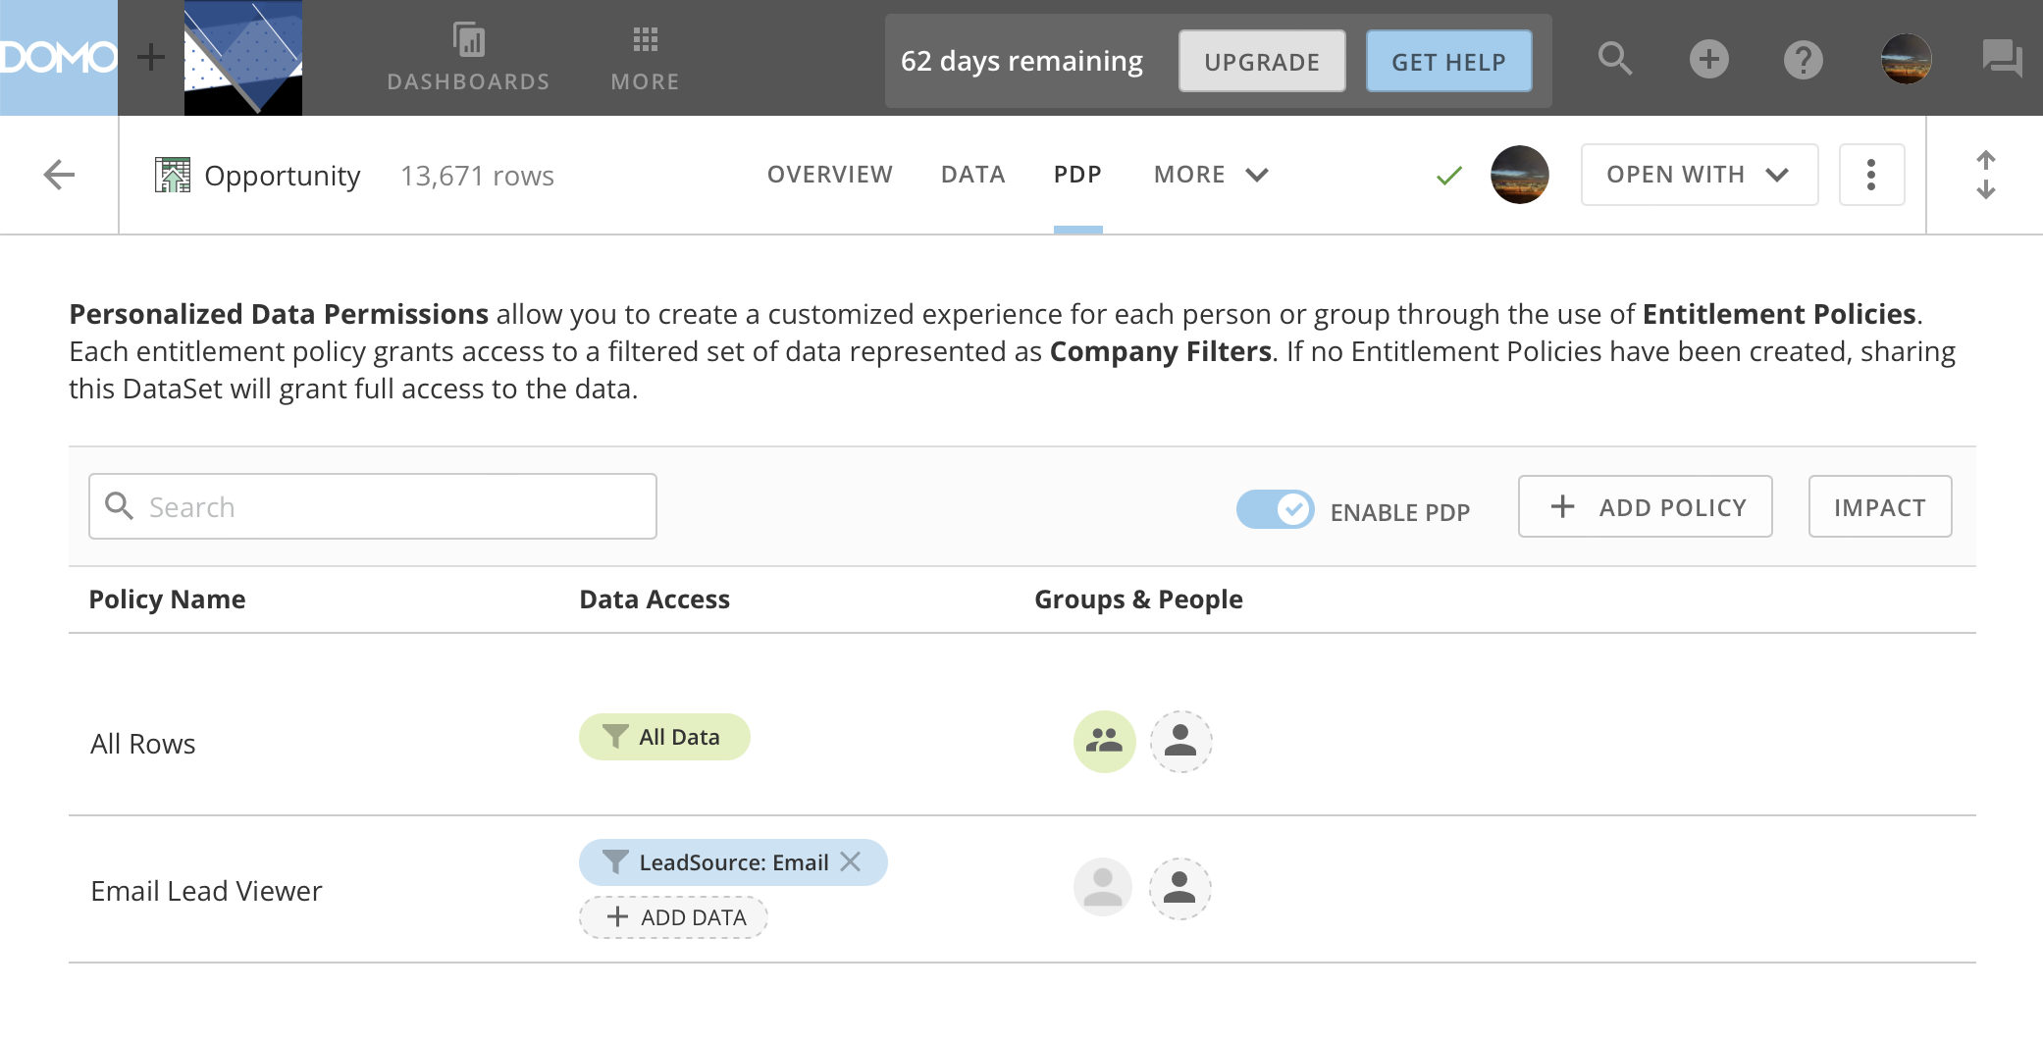

Slide 3
Dataset Versioning
Replace
Append
Legend
v1
v1
Queryable
v2
v2
Not Queryable
v3
v3

Slide 4
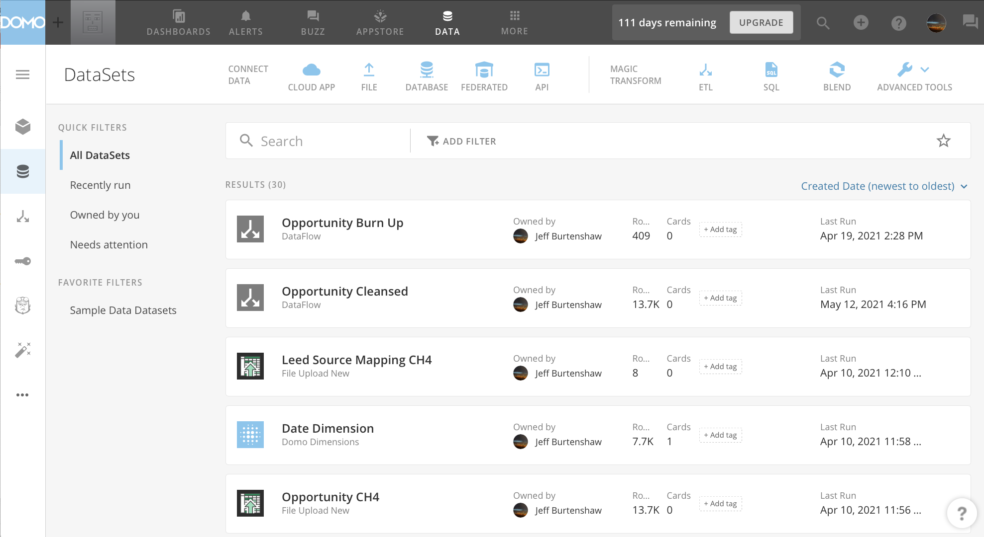
1
2
3

Slide 5
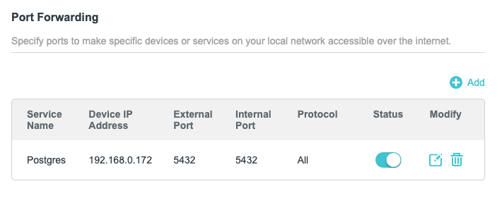

Slide 6
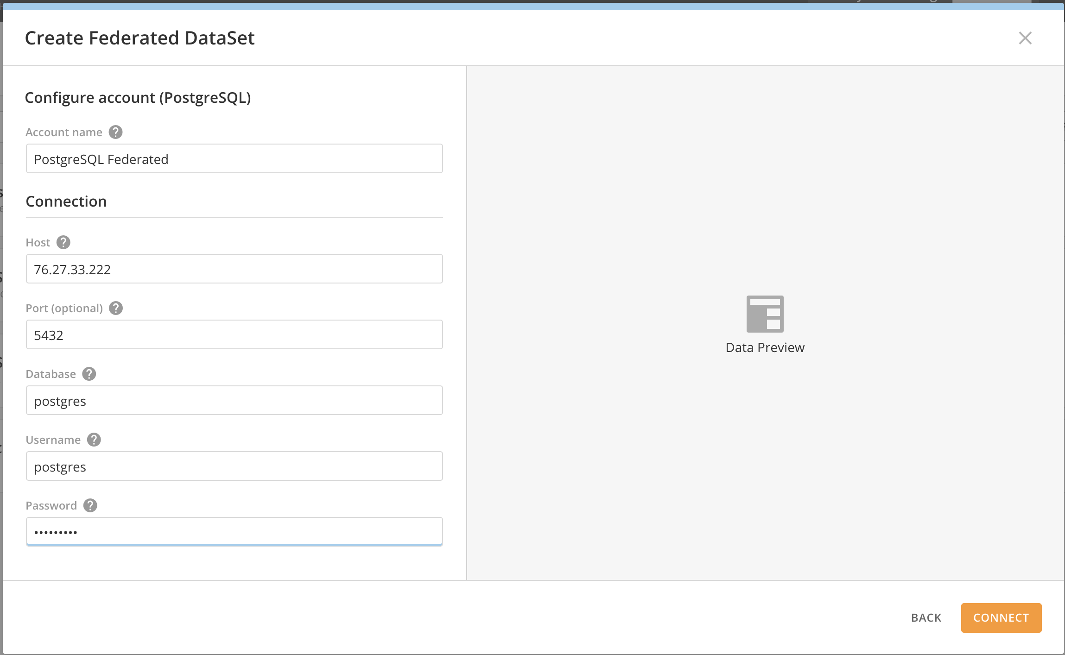
##.##.##.###

Slide 7
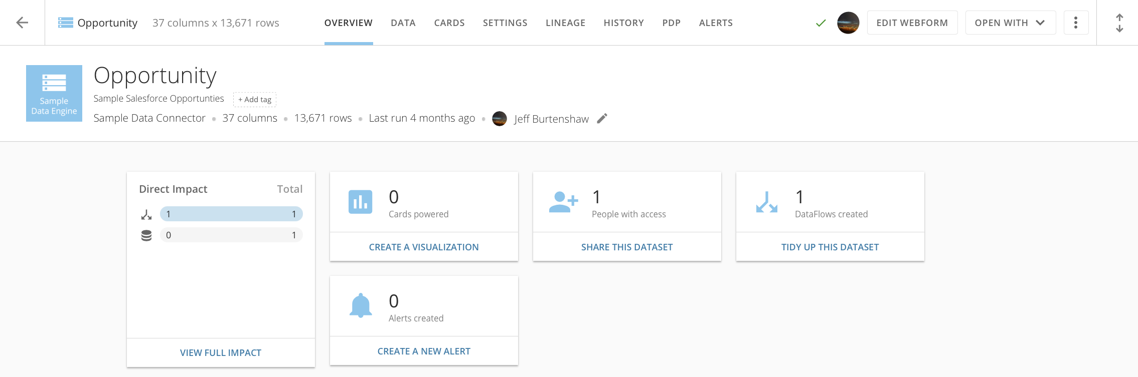
Dataset Name
# Fields
Volume
Refreshed
Tabs
Options
Owner
Change Owner
Tab Panel
Connector Type

Slide 8
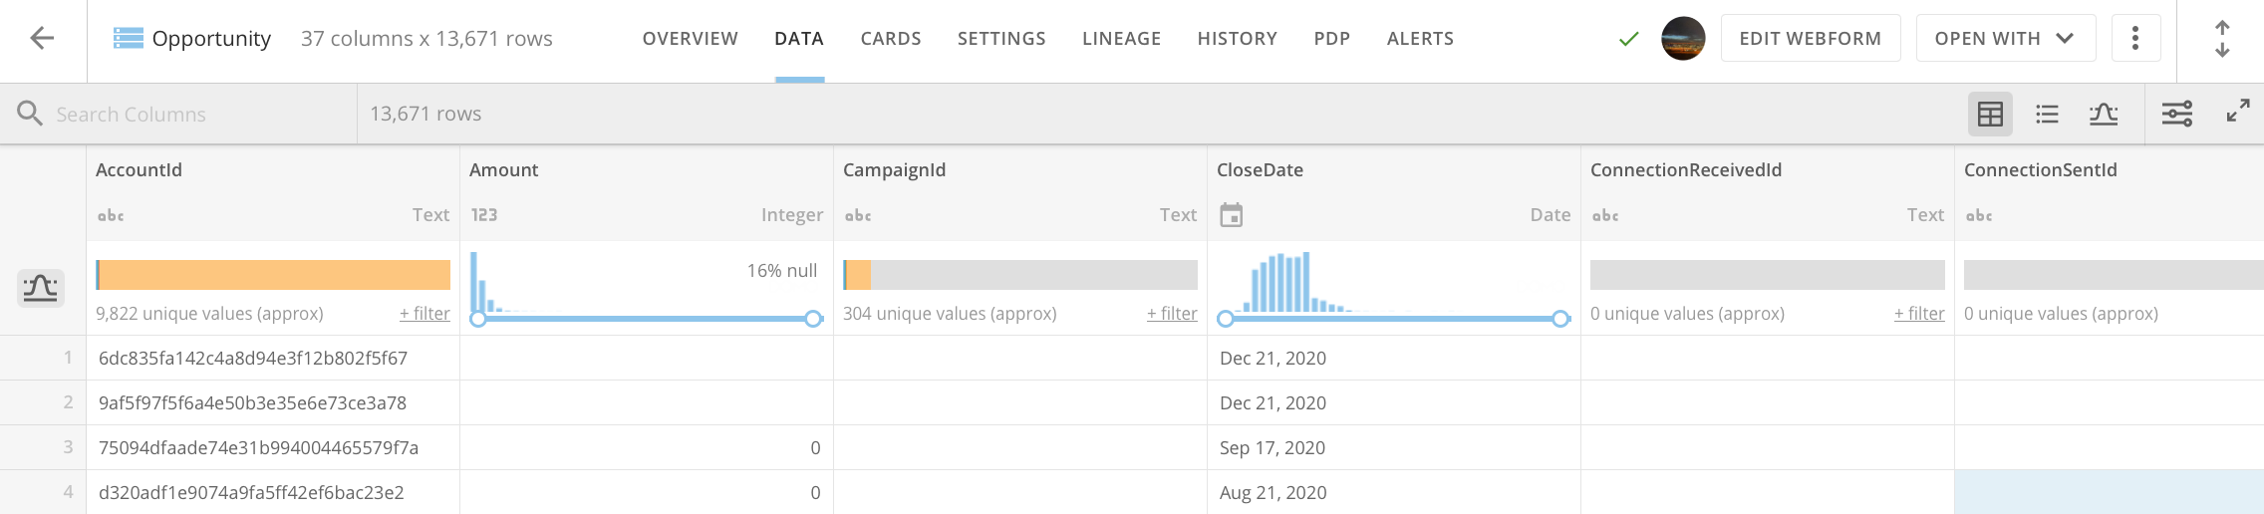
Column Name Search
Column Name
Column Data Type
Table View
Schema View
Stats View
Advanced Options
Data Distribution & Filter Values Toggle
Column Filtering
Column Sort
Full Screen Toggle

Slide 9
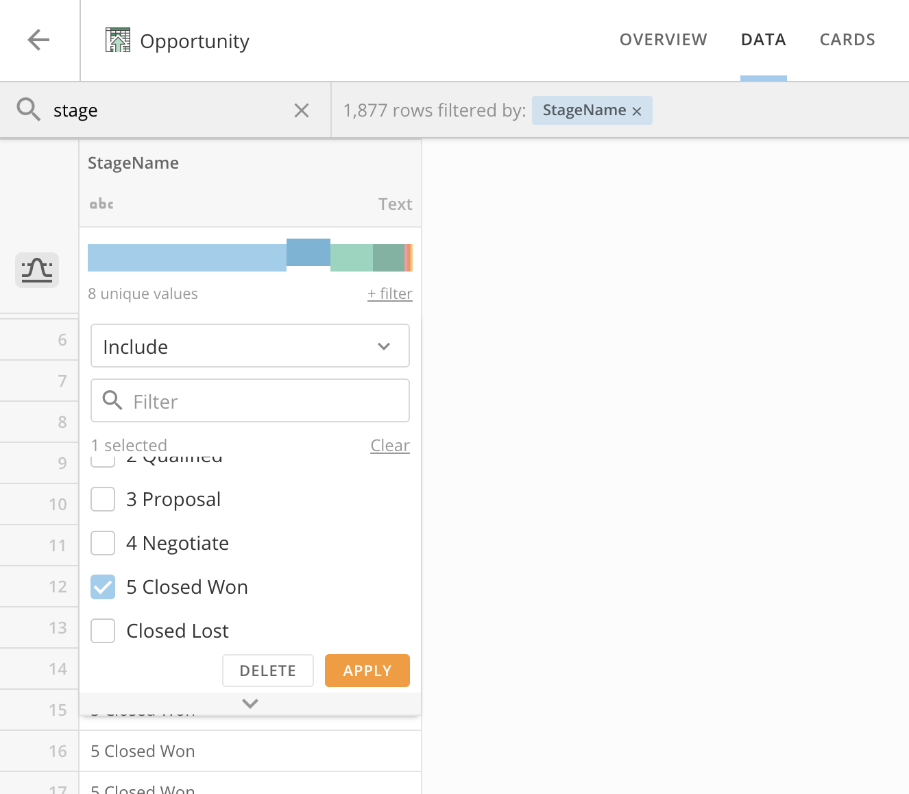
Applied Filters

Slide 10
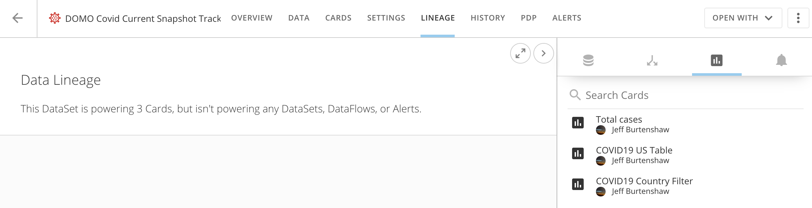

Slide 11
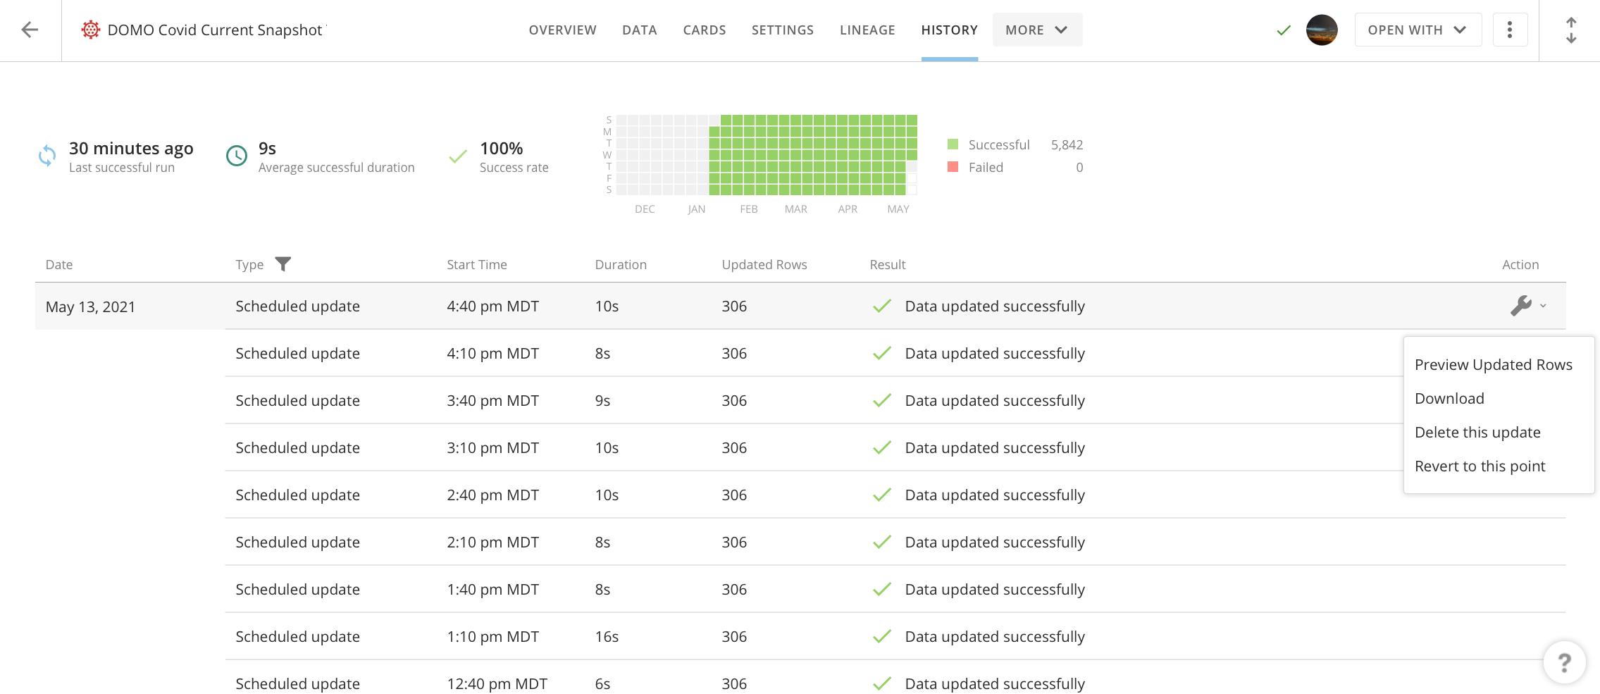

Slide 12
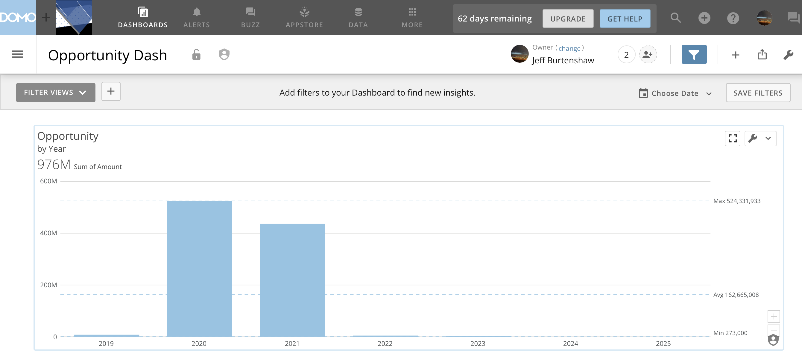

Slide 13
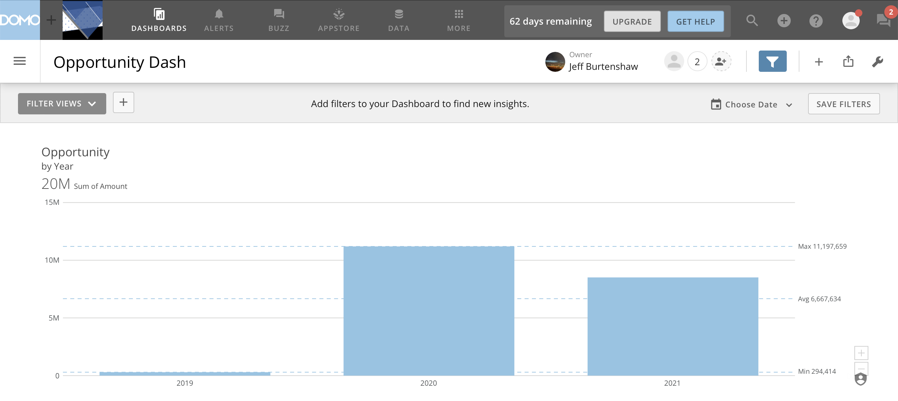

Slide 14
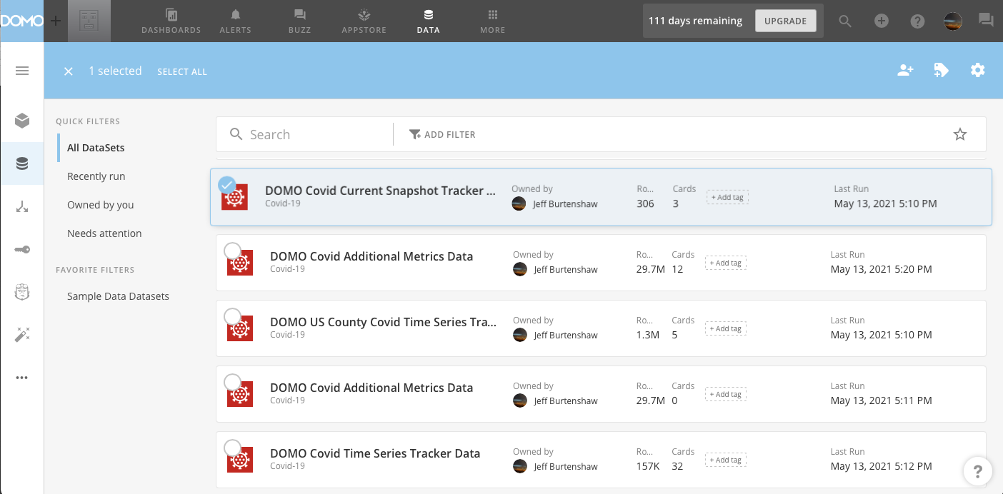
Batch Operations Ribbon
Dataset Select
Commands
Manage Dataset Tags
Share Datasets

